Slide 1
A Multilingual News Surveillance and Classification System
By Adam Fairlie
Notes:
I’m Adam and for my project I have developed a Multilingual news surveillance and classification system

Slide 2
Motivation
Diseases can spread very quickly, it’s important to quickly detect them.
Traditional methods are often slow and lacking in coverage
Digital news surveillance provides quick updates
This project improves BioCaster, an existing digital news surveillance system
Notes:
Diseases can spread very quickly and cause widespread harm, so early detection and prevention is crucial. Traditional methods can be slow and lacking in coverage in low-resource areas. Digital news surveillance has been effective in quick detection and prevention of outbreaks. This project improves an existing disease surveillance system. BioCaster

Slide 3
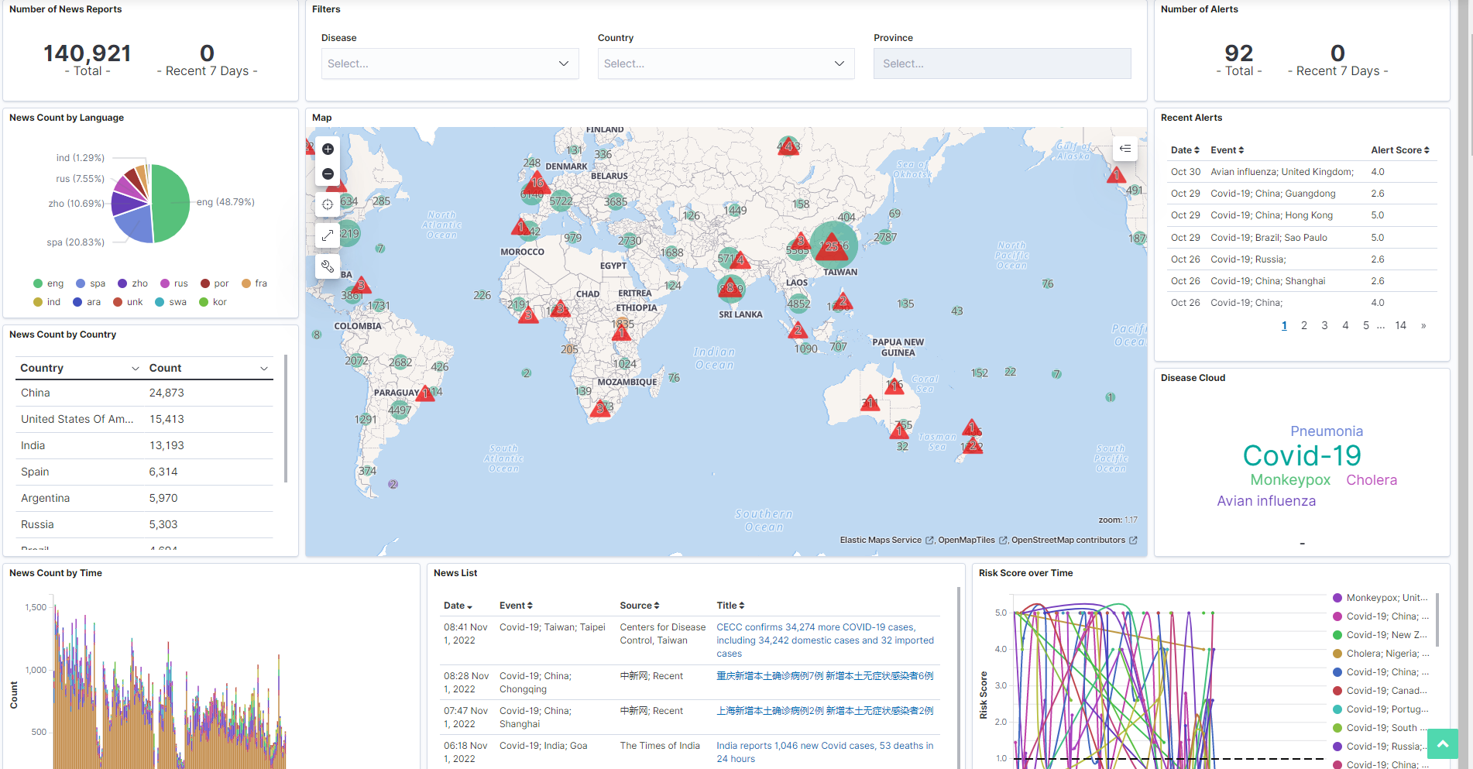
Motivation
BioCaster collects news data and provides visualisations
Notes:
BioCaster collects online news data in many languages and provides location-based disease alerts on an online visualisation

Slide 4
Motivation
However, there are some issues in the current system:
Data collection methods are limited (only RSS feeds)
The system relies on machine translation, which can be biased.
This project aims to improve the system in these areas
By developing a system to collect more sources of news data
By experimenting with multilingual machine learning models
Notes:
The current system has two main issues this project will address. BioCaster only currently collects from RSS data, which is limited often to larger data sources and can exclude minority languages and countries. The system relies on translating articles to English, which can be biased and resource-intensive.

Slide 5
Project Contributions
This project is composed of two main contributions:
Digital news surveillance system
Multilingual news article classification experiment
Notes:
The project is split into two main contributions. A new digital news surveillance system based on the original BioCaster system to improve some areas, and research on multilingual news classification

Slide 6
Digital News Surveillance System
Improved, robust multilingual news collection system
News websites and RSS feeds
Real-time news data visualisations
Web interface for viewing/controlling system
Notes:
The digital news surveillance system will improve the data collection, collecting richer information from both news websites and RSS feeds, with room for new sources to be added. It will provide real-time visualisations based on the original BioCaster visualisations, and will implement a web interface for viewing these visualisations and controlling the news collection system.

Slide 7
Design
We will design the system to be:
Modular
Extensible
Configurable
Notes:
The digital news surveillance system will improve the data collection, collecting richer information from both news websites and RSS feeds, with room for new sources to be added. It will provide real-time visualisations based on the original BioCaster visualisations, and will implement a web interface for viewing these visualisations and controlling the news collection system.

Slide 8
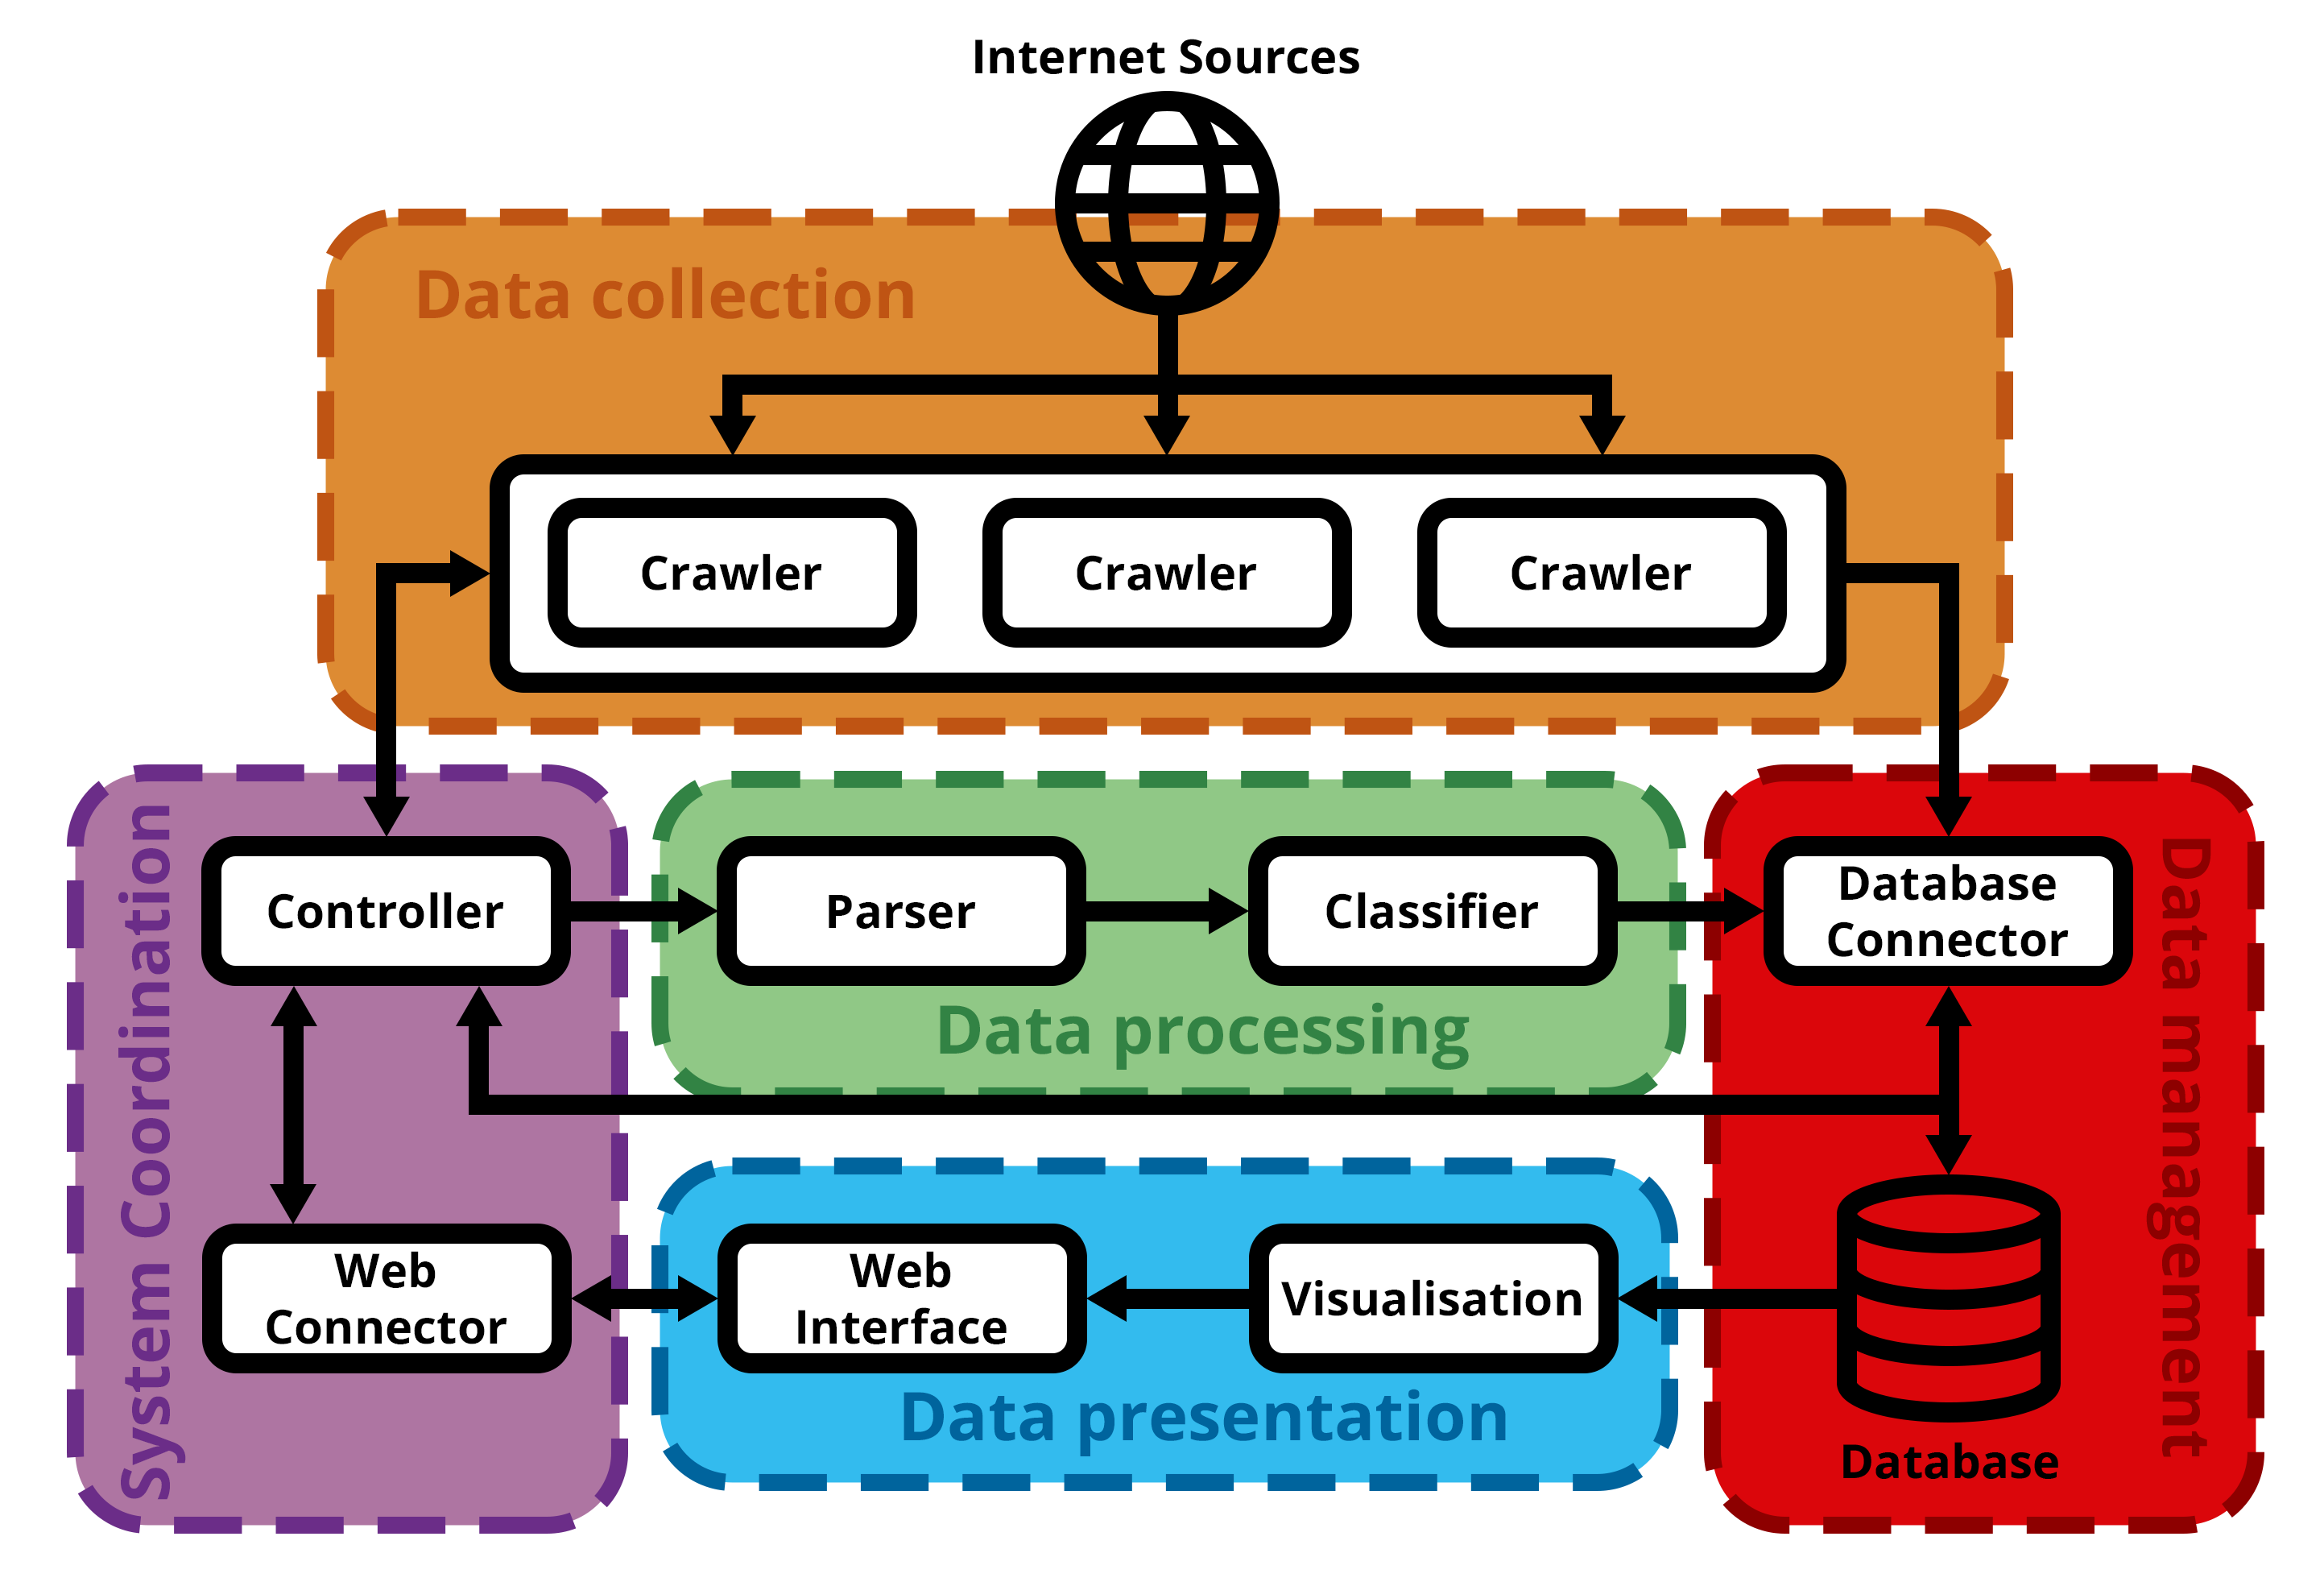
System Design
Notes:
Here is an overall diagram of the system components and how they interact

Slide 9
Digital News Surveillance System
Data collection
Responsible for obtaining new articles
Data processing
Parsing and classifying news data
Data management
Storing data permanently
Data presentation
Allow viewing of data and system state
System Coordination
Bringing everything together
Notes:
The system is split into 5 main subsystems: The data collection system retrieves new articles. The data processing system extracts information and classifies these articles. The data management system provides permanent storage of this information. The data presentation subsystem allows data and system state to be viewed. The system coordination subsystem brings all the components together.

Slide 10
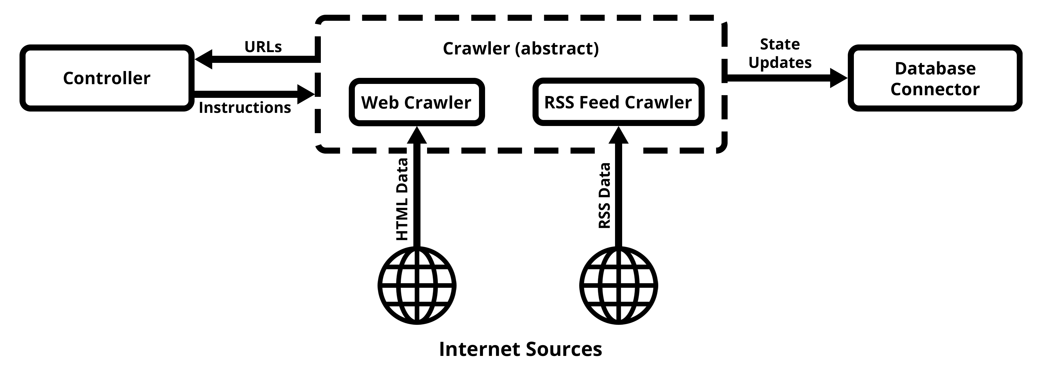
Crawler
Crawls a source URL for a list of news URL’s
News websites, RSS feeds
Notes:
The crawler will retrieve a list of news article URL’s from a source URL, and update its own state in the database

Slide 11
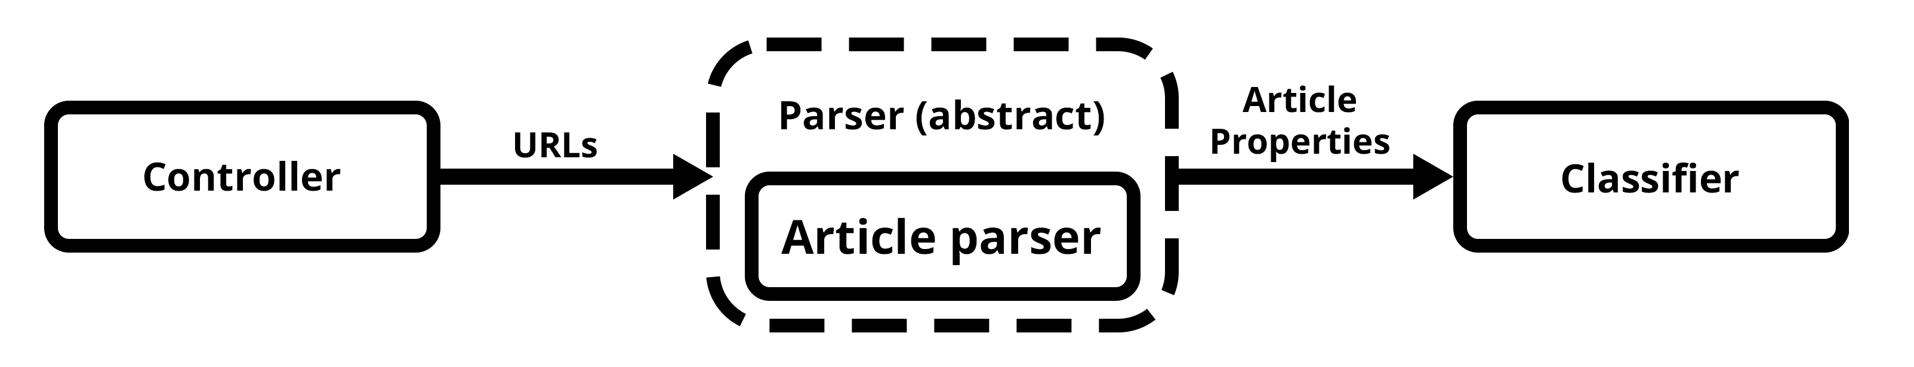
Parser
Scrapes a news URL for detailed information
News articles
Notes:
The parser will scrape the URLs from the crawler for detailed information such as headline, body and publish date, and pass this to the classifier

Slide 12
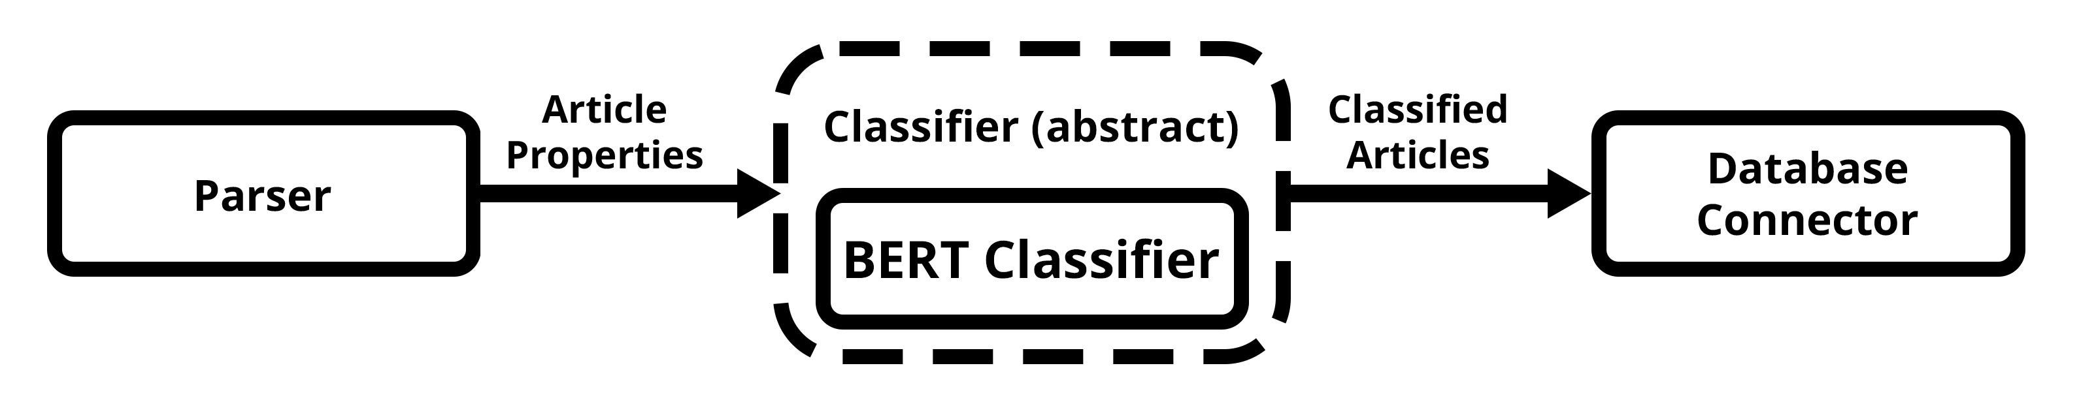
Classifier
Assigns category to incoming news data
BERT-based classifier
Notes:
The classifier will assign a category to each incoming article, using the trained transformer model from the experiment

Slide 13
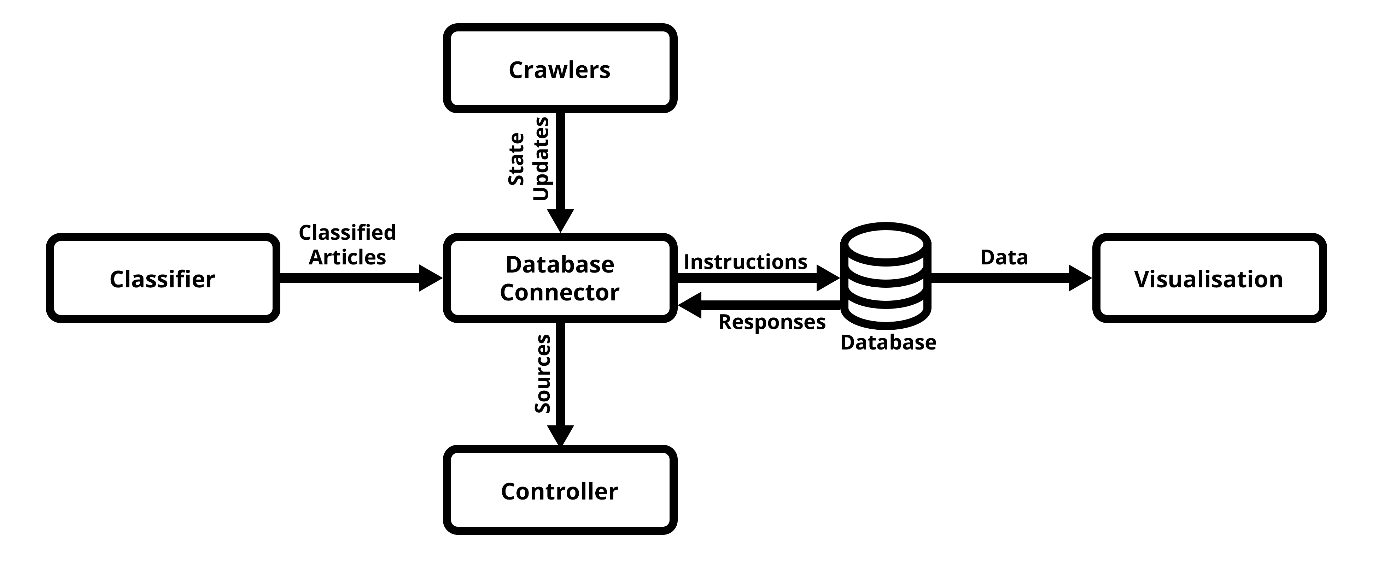
Database/connector
Store new articles
Load / manage sources
Notes:
New sources are loaded from the database when the program starts, and new articles are added by the classifier. The database will also store the state information of sources.

Slide 14
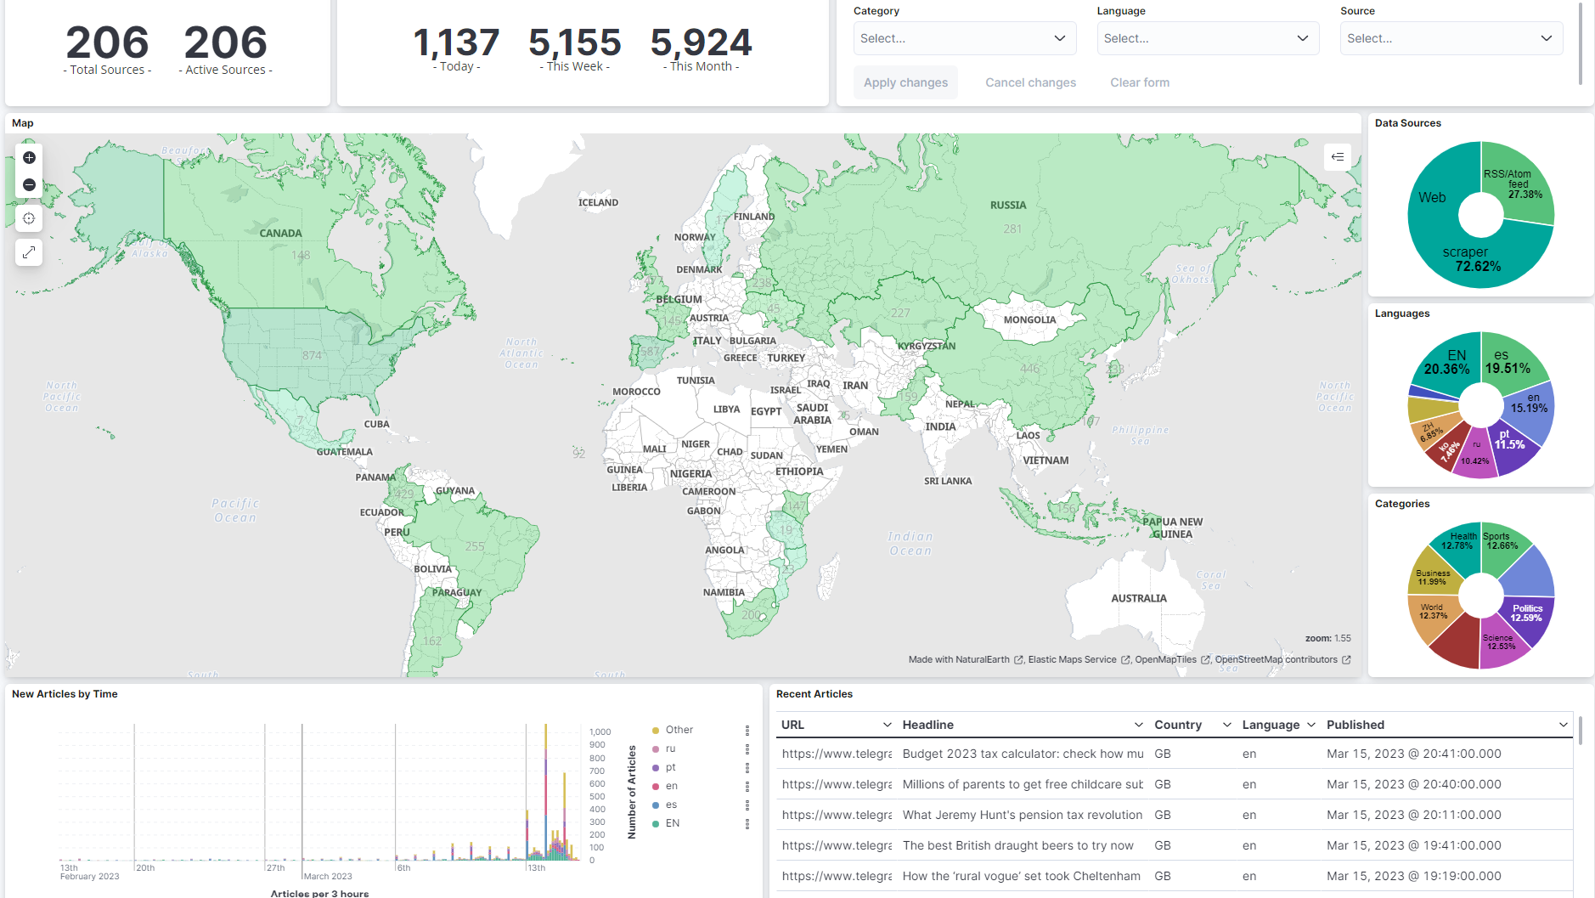
Visualisation
Based on original BioCaster visualisation
Reflects new components
Notes:
The visualisation is based on the original BioCaster visualisation, but provides information collected by our system such as source type and category information instead of the disease information which is not implemented.

Slide 15
Web interface
Enabling / disabling scraping system
Enabling / disabling individual data sources (Crawlers)
Adding / deleting sources
Viewing stale sources
Viewing visualisation
Web connector communicates with scraping system
Notes:
The web interface is responsible for providing an interface for controlling the scraping system and its sources, including turning the system on and off, turning individual sources on and off, removing and adding them and viewing which ones are stale. It will also host the visualisation. The web connector will facilitate the communication between the system and the web interface

Slide 16
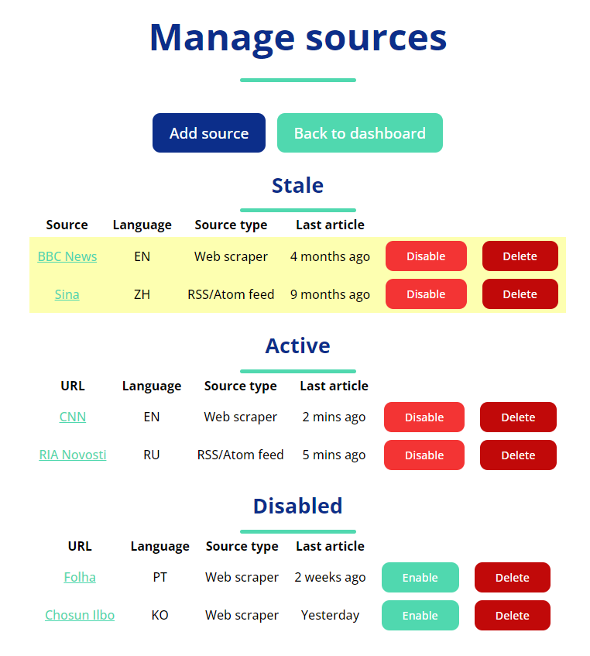
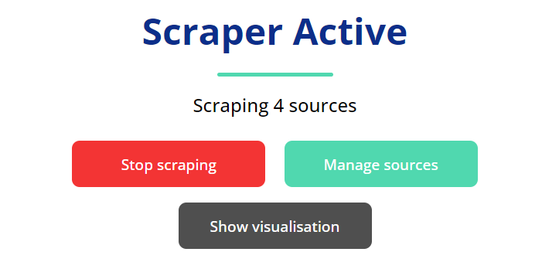
Web interface
Notes:
These are the pages of the web interface

Slide 17
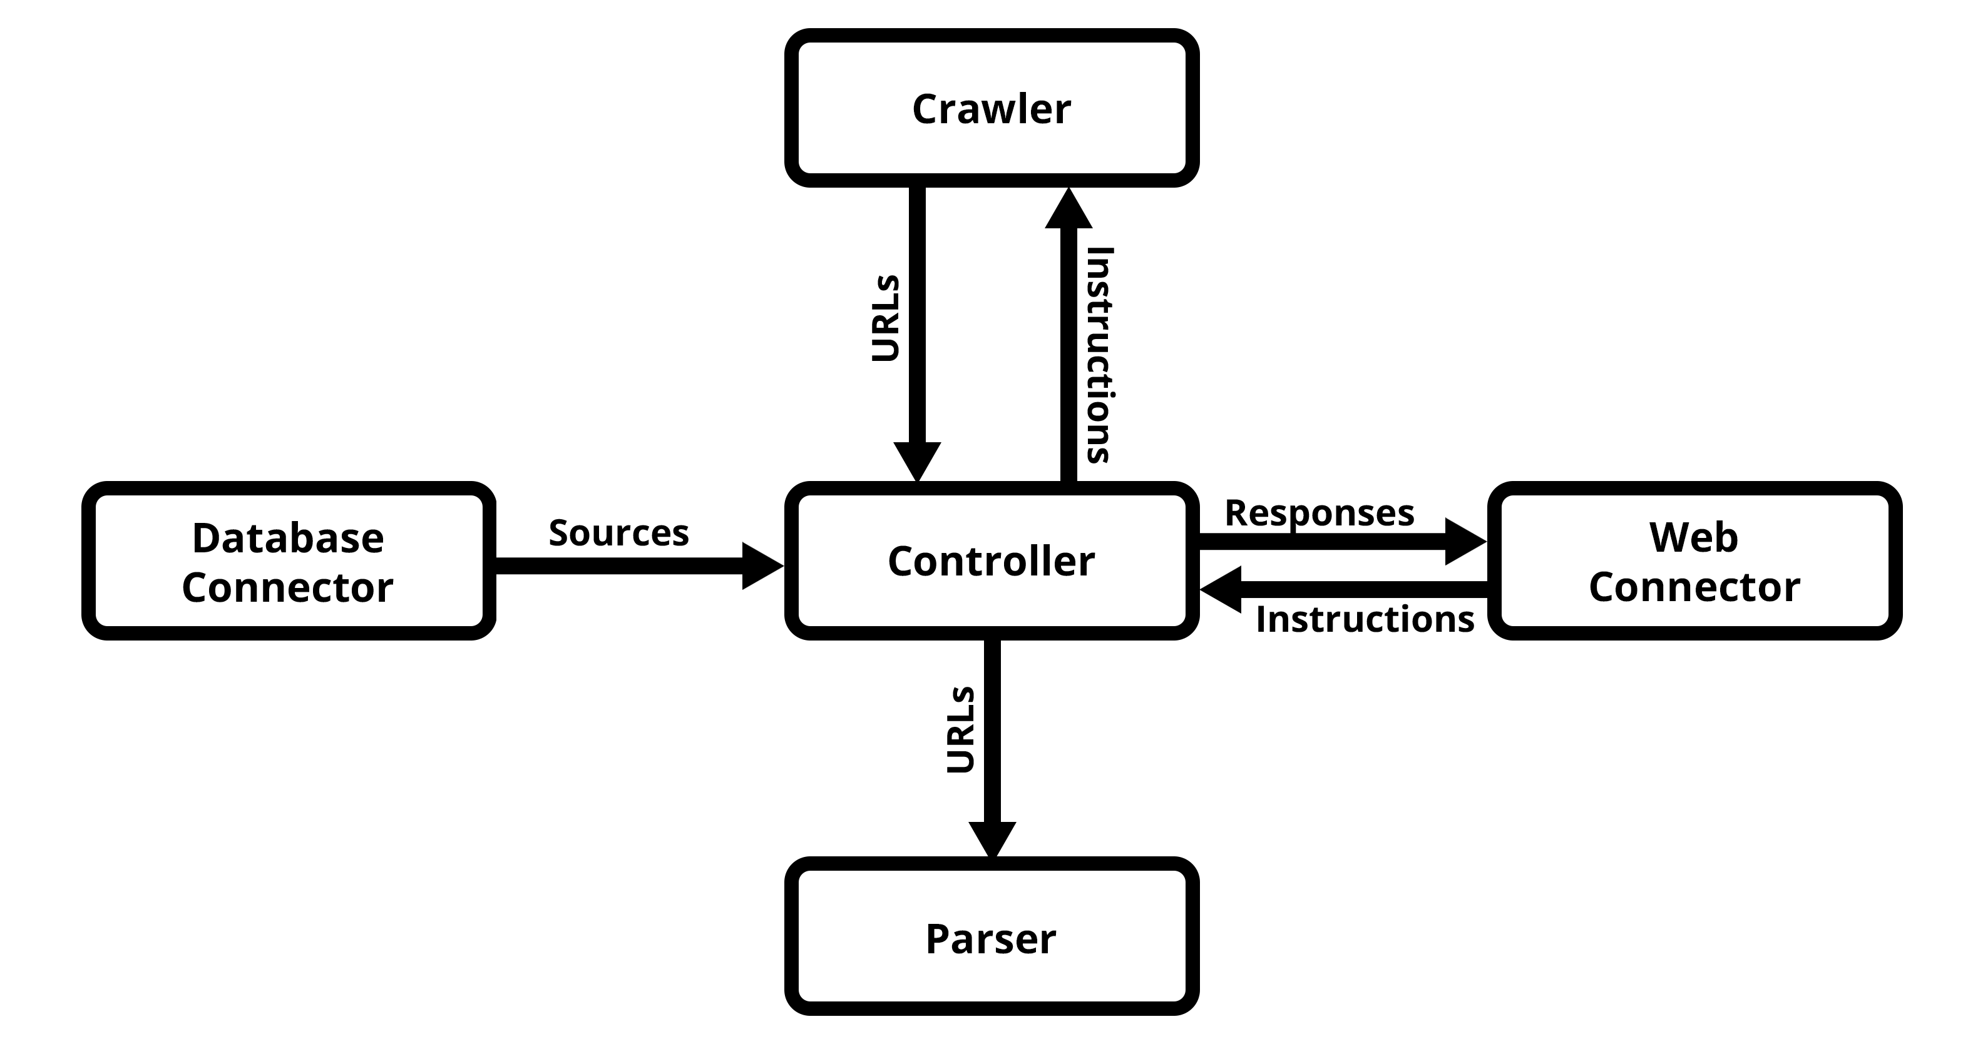
Controller
Load sources and initialise crawlers
Pass articles to parser
Communicate with web interface
Notes:
The controller brings the system together, retrieving the sources from the database and initialising the crawlers, sending the new articles to the parser, and communicating with the web interface,

Slide 18
Implementation
Crawlers, Parser and Classifier developed in Python
Crawlers and Parser use Newspaper3K library
Classifier uses Huggingface transformers library
Database and visualisation uses Elastic stack
Elasticsearch noSQL database
Elastic Kibana real-time visualisations
Web interface uses standard HTML/CSS/JavaScript
Communication with scraper system through Eel library
Notes:
The code is written in python, using news scraping library newspaper3k and rss feed library feedparser to collect news data. The classification system uses huggingface, a library for easy access to transformer models. The database and visualisation use the elastic software stack, with elasticsearch noSQL data storage and kibana producing live visualisations from this data. The web interface uses standard web technologies, and connects to the scraping system using the library Eel.

Slide 19
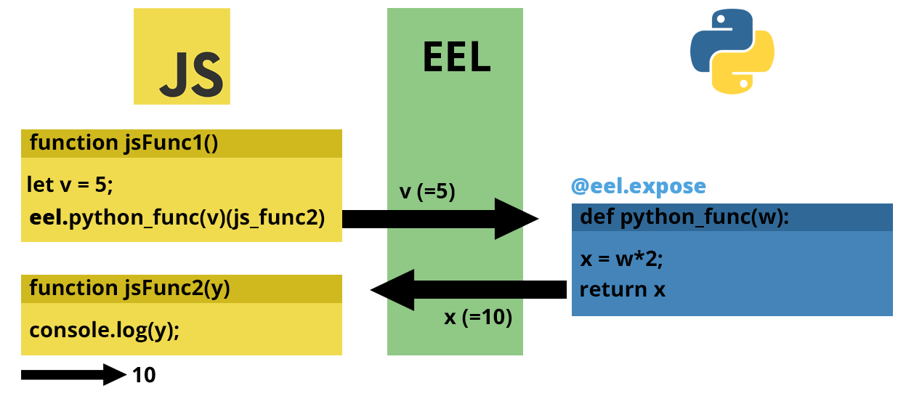
Eel communication
Notes:
In the python code, eel creates a local web server which can communicate with the code using funcions, and return the value from python as the argument to another function, shown in the example here.

Slide 20
Demonstration
of Digital News Surveillance System
Notes:
Now I will demonstrate the system

Slide 21
Evaluation
Questionnaire sent to BioCaster team and University peers
9 responses
Does the visualisation provide a complete and effective overview of the data collected?
Does the web interface allow users to easily and effectively manage the underlying web scraping system?
Notes:
A questionnaire was sent to the biocaster research team and some university students, receiving 9 reponses. The two main questions were these

Slide 22
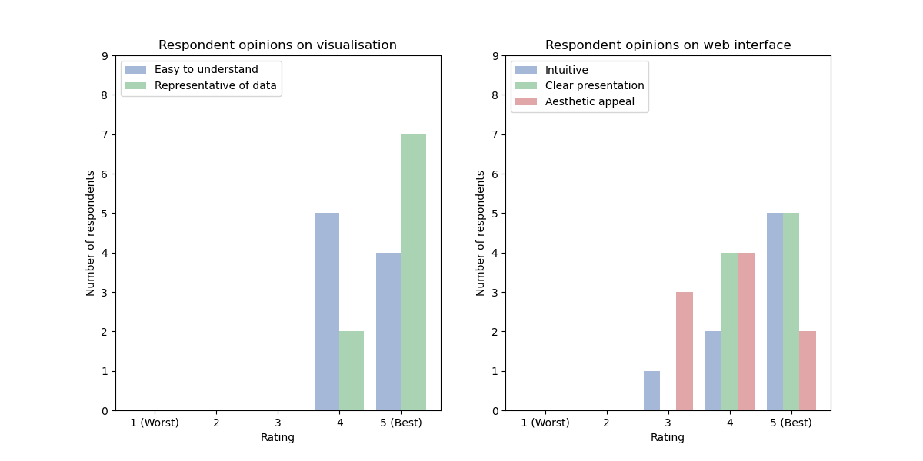
Evaluation
Notes:
Here are the results of the rating scale survey questions

Slide 23
Evaluation
Overall, the visualisation was found to be easy to understand and represent the data well
4.44/5 Easy to understand, 4.78/5 Representative of data
Some components difficult to interpret
Some interesting information missing
The web interface is mostly intuitive and clear, but has some room to improve in aesthetics
4/5 Intuitive, 4.56/5 Clearly presented, 3.89/5 aesthetically appealing
Lack of an “about” page can make purpose unclear
Some technical bugs
Notes:
The results suggest the visualisation is easy to use and represents the data well, but has some minor problems with components being difficult to interpret or missing some interesting information, such as top sources by number of articles. The web interface has more room for improvement, particularly in aesthetic appeal, and lacks a clear about page to convey the purpose of the system.

Slide 24
Project Contributions
This project is composed of two main contributions:
Digital news surveillance system
Multilingual news article classification experiment
Notes:
We will now look at the second contribution, the classification experiment

Slide 25






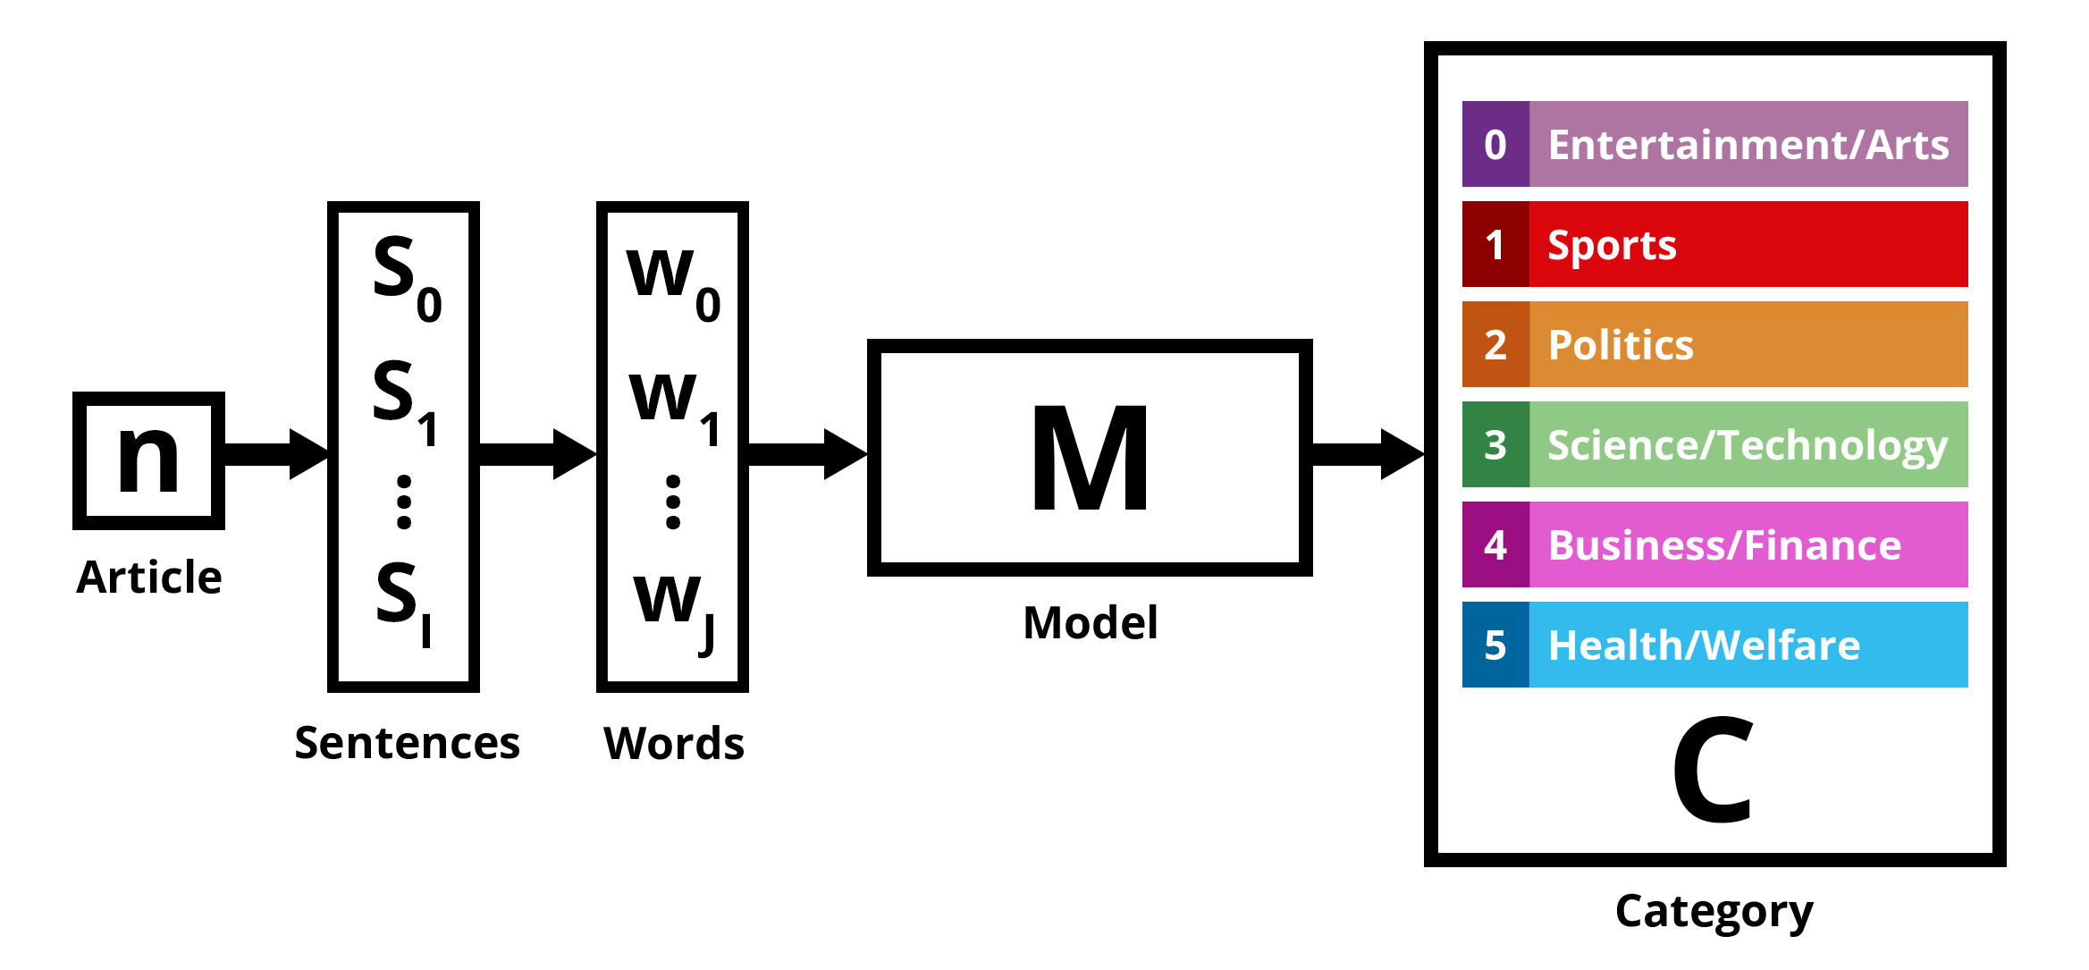
Task definition
Classify a news article in one of 6 Languages
English, French, Spanish, Portuguese, Indonesian, Mandarin
Into one of 6 Categories
Entertainment/Arts, Sports, Politics, Science/Technology, Business/Finance, Health/Welfare
Notes:
This experiment will consider categorising news sources from 6 languages into one of 6 different categories

Slide 26
Multilingual News Classification
How effective is machine translation (…) as a method of upsampling in (…) multilingual models?
How effective are models trained on public data (…) when used to classify collected news data directly from (real-world) sources(…)?
What level of performance can be achieved by multilingual models (…) on collected articles from (real-world) sources(…)?
Notes:
The main research questions were these three

Slide 27
Models
Two state-of-the-art multilingual transformer models
Multilingual BERT (mBERT)
XLM-RoBERTa
Notes:
We considered two state of the art transformer models, multilingual bert and XLM roberta

Slide 28
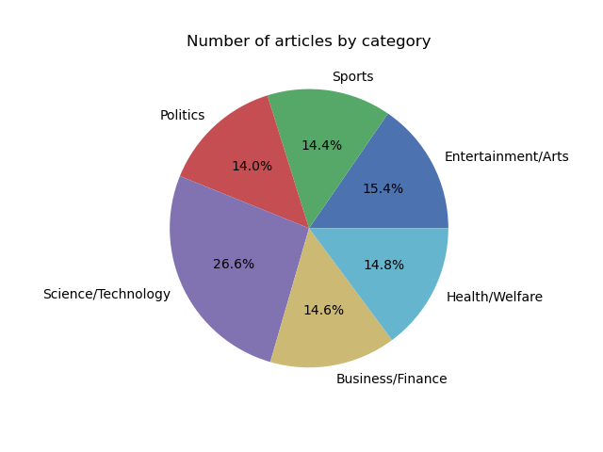
Public Dataset
From Huggingface hub, 3,147 documents
Translated into all 6 languages (18,882 documents)
Notes:
We used data from the huggingface online dataset hub which had 3,147 documents, and translated the data into all 6 languages

Slide 29
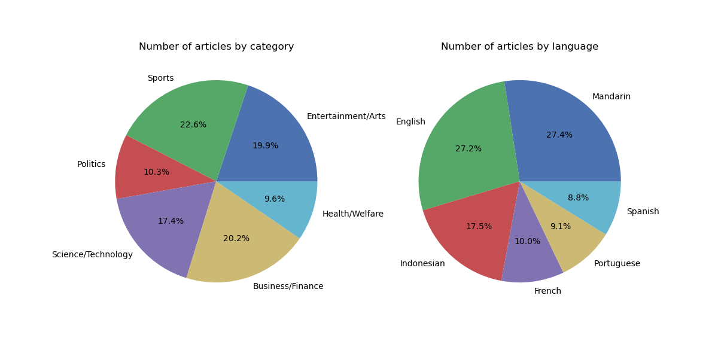
Real-world Dataset
Collected from real-world sources of each language
Self-categorised by URL and RSS feed
12,846 Documents
Notes:
We also collected news from real-world sources from each of the 6 languages using our scraper system, using the categorisations from the websites themselves in the URL or in category RSS feeds. We retrieved 12,846 documents

Slide 30
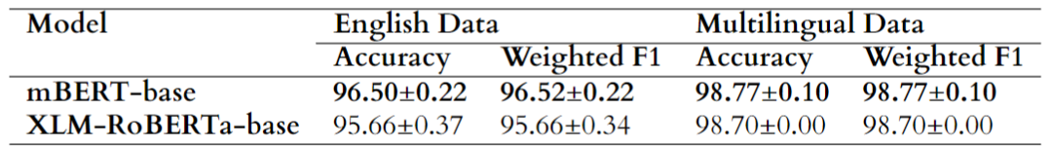
Effectiveness of Upsampling
Trained and tested models on English only public data, then on multilingual public data.
Improved performance on multilingual dataset
Notes:
In the first experiment, we trained and tested the models on English only public data then on multilingual public data, and found an improved performance using multilingual data

Slide 31
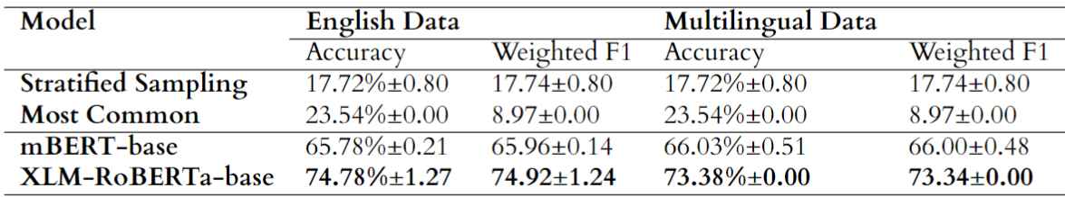
Model transferability
Previously trained models tested on real-world dataset.
Compared against static baseline models
Outperform baselines, yet significant performance loss
Notes:
Next, we tested how these previously trained models would perform on the real-world collected data. They outperformed the static baselines, but performed significantly worse than before.

Slide 32
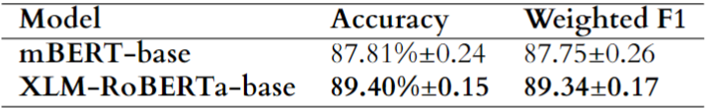
Effectiveness on real-world data
Train and test models on real-world collected data
XLM-RoBERTa model has high accuracy on real-world data
However, lower than models trained on public data
Notes:
Finally, we trained and tested on real-world collected data, and found XLM Roberta to be the most effective model, achieving 89.4% accuracy

Slide 33
Summary
Digital News Surveillance System
Collect webpage and RSS feed data from multilingual sources
Classify results into category
Produce visualisations from article data
4.44/5 Easy to understand, 4.78/5 Representative of data
Provides web interface for controlling the system
4/5 Intuitive, 4.56/5 Clearly presented, 3.89/5 aesthetically appealing
Multilingual news classification experiment
Machine translation can be used to upsample data
Models can learn some information from public data
Multilingual models can achieve high (~89%) accuracy on real-world data
Notes:
We provided two main contributions, developing a system to collect webpage and RSS feed data from multilingual sources, produce real-time visualisations and created an interface to control the system. We also found promise in using machine translation to upsample, and trained a multilingual model to achieve almost 90% accuracy on real-world data. Thanks for watching

